Slide 1
Divergence
Group Project Pitch
Presented by Mikail Kahya & Finian Horrie
Notes:
Game name: Divergence

Slide 2
Game Idea
First Person round-based survival
Limb replacement
Abilities and weapons
Human
Dynamic map
Notes:
First person round based survival game
Can replace limbs with ones gathered from opponents
Give access to new abilities and weapons
Crossbow arm
More versatile melee attack
Dash
Passive head
All enemies were once human
The player was also, but they’re under control of a higher being, allowing them to stay sentient
This allows the replacing of limbs
Dynamic map
Map walls can be torn down by boss monsters, allowing map size increase

Slide 3
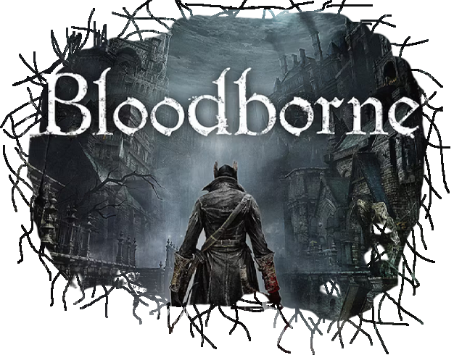
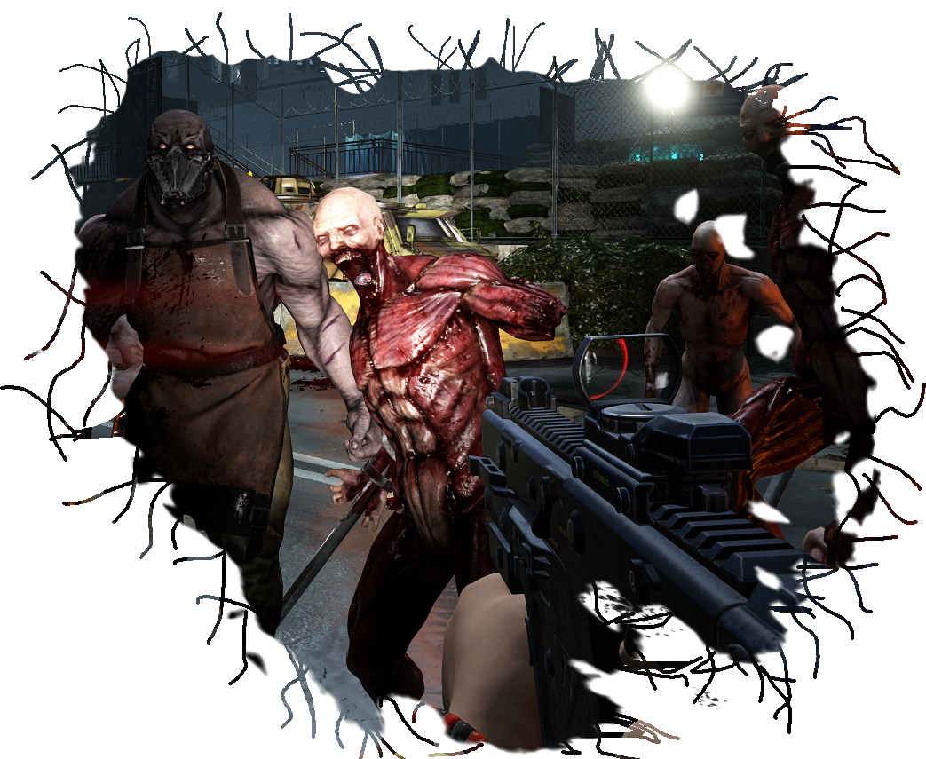
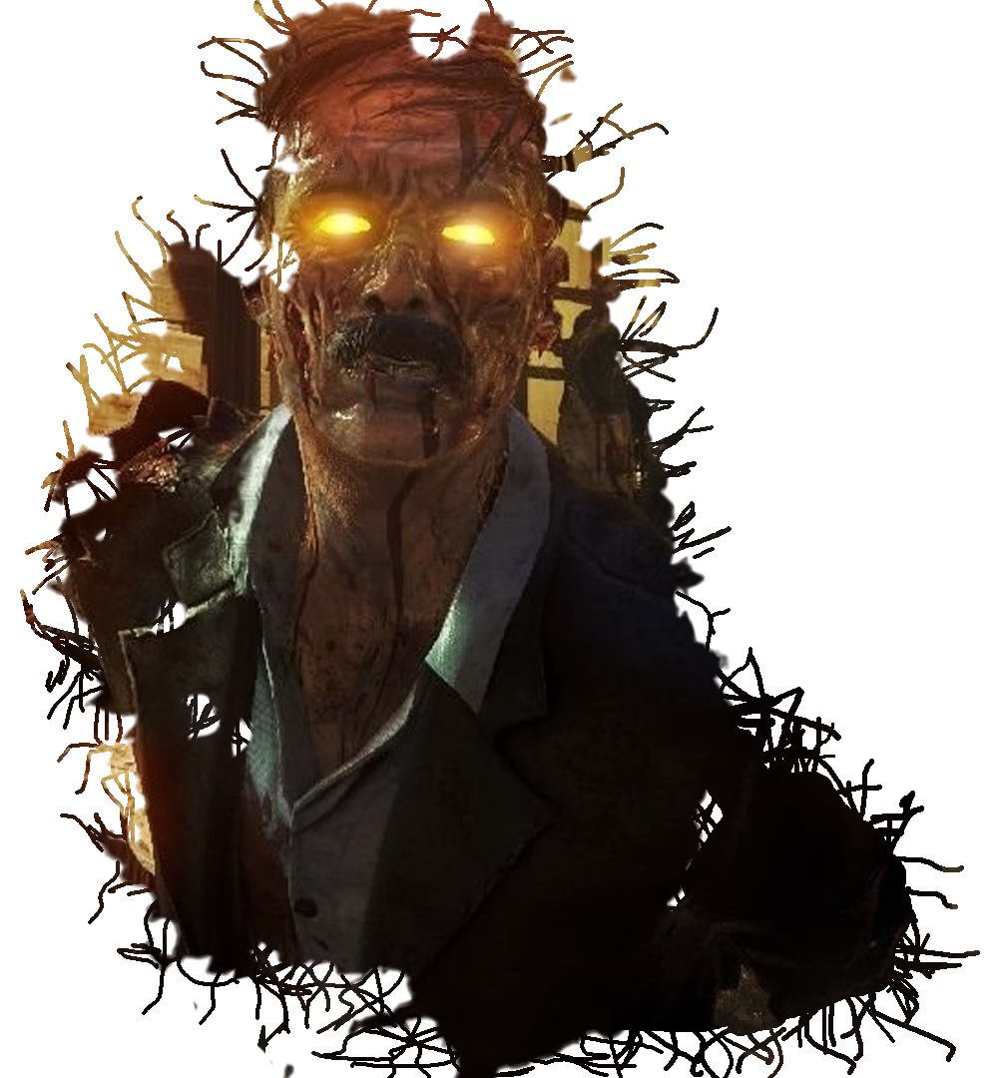
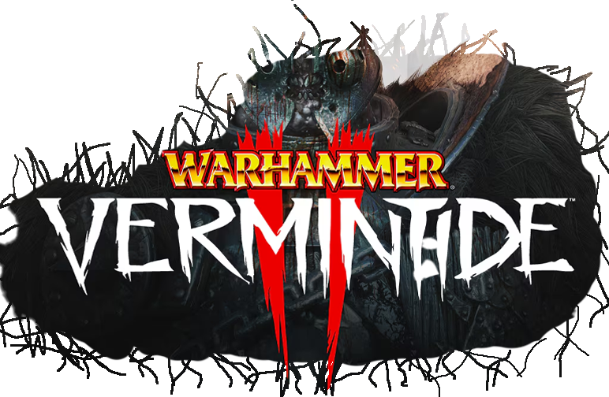
Inspiration
Notes:
Game Inspiration
Call Of Duty Zombies
Round based system
Chased by crowds
Powerful weapons with upgrade system
Altered humans
Killing Floor
Same points as COD
Upgrade station between rounds
Class specialization
Warhammer Vermintide
Bloodborne

Slide 4
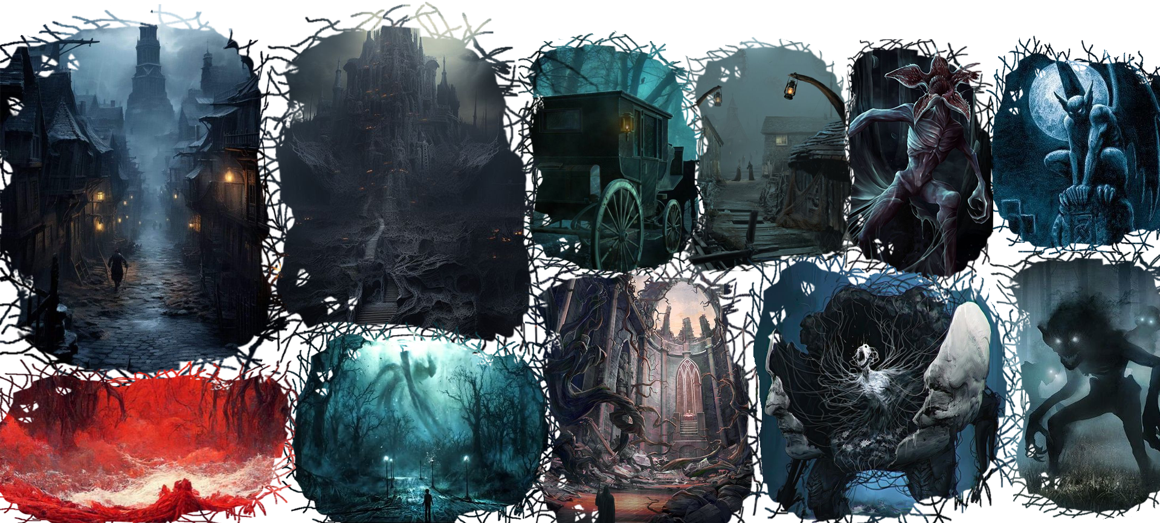
Visuals (Mood)
Notes:
Mood
Dark, eerie
Should feel like an abandoned/haunted city
Dark vines and ivy should be omnipresent in the city
Enemies
Mutilated, modified human like monsters
Should instil an uneasy feeling into the player
Variety

Slide 5
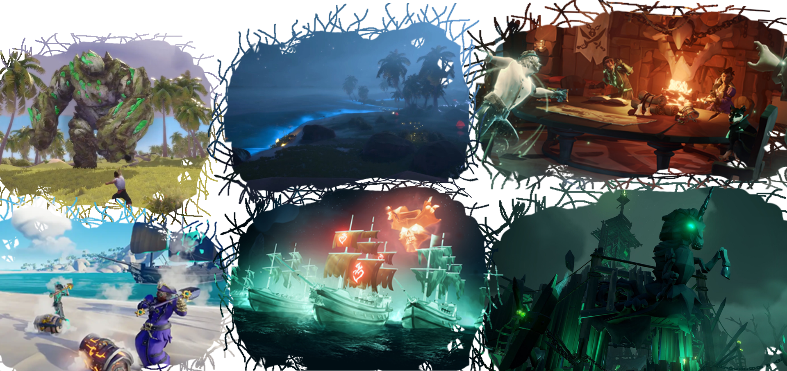
Visuals (Style)
Notes:
Style
Simple textures
Lighting is the main focus
Many visual effects will be used (fire)
Medium model complexity
Poppy colours and bloom

Slide 6


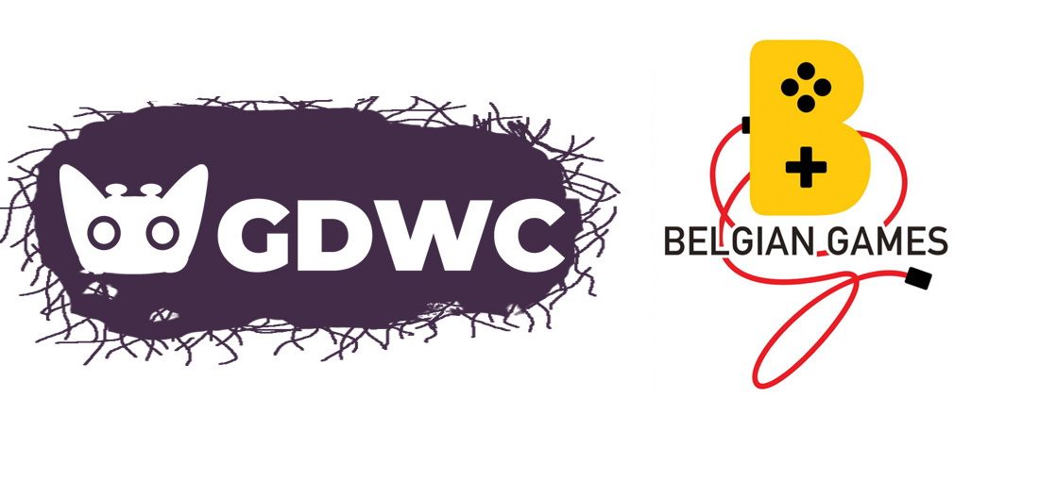
Goals
Game we wanted
Learn UE 5.4
Store release
Contests
Notes:
Goals
What we are planning to make is a game that we wanted to see made for a long time, Round based survival is one of our favorite genres
We want to dive into Unreal 5.4 to learn the C++ side extensively
After the project is finished, we want to have a game store release and/or hand in our project to various game competitions like GDWC and the Belgian game awards

